Slide 1
SafeHome Project
[Team 2]
20130711 Seokju Hong
20121022 Youngseok Kim

Slide 2
Contents
Deployment diagram
Feature demonstration
Code complexity analysis
Testing/coverage result
Every progress/achievement is saved in github repository : https://github.com/Suckzoo/CS350

Slide 3
1. Deployment diagram

Slide 4
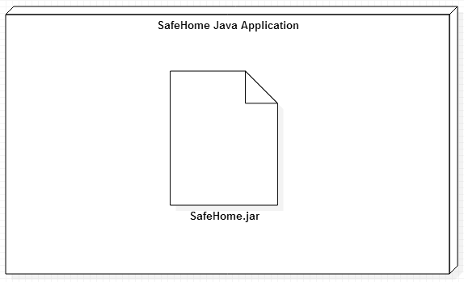
Deployment diagram of reduced project

Slide 5
2. Feature demonstration

Slide 6
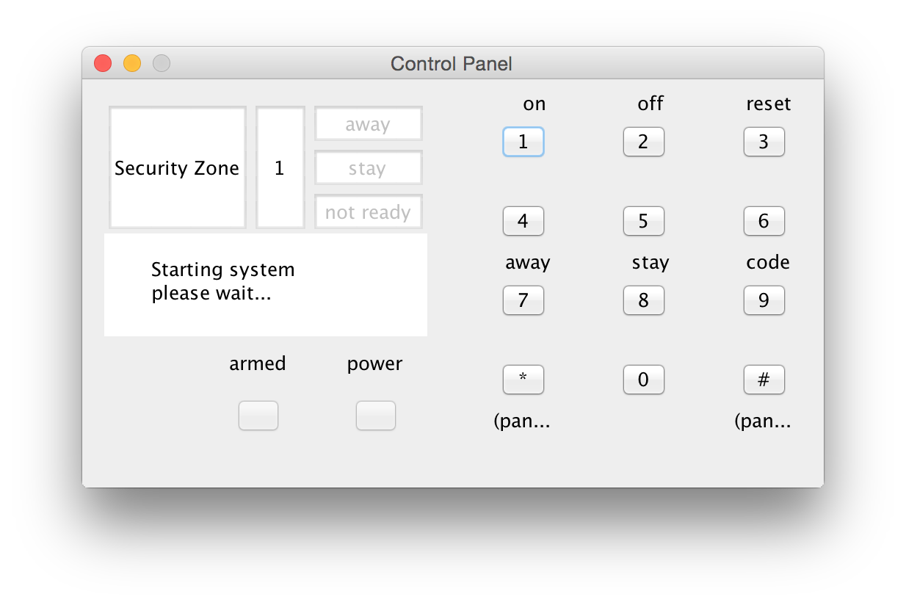
Control panel

Slide 7
Control panel
Supporting features:
Safehome booting/shutdown/reset
Arming sensors (Away mode)
Disarming sensors (Stay mode)
Manual panic override

Slide 8
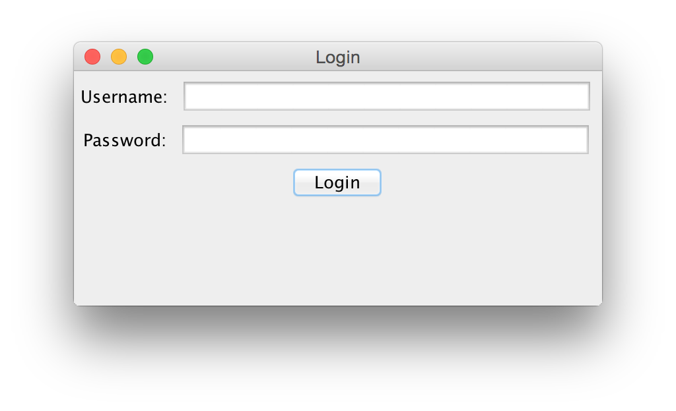
Login

Slide 9
Login
Supporting features
User ID/Password input
Authentication check
If login succeeds, configuration interface shows up.

Slide 10
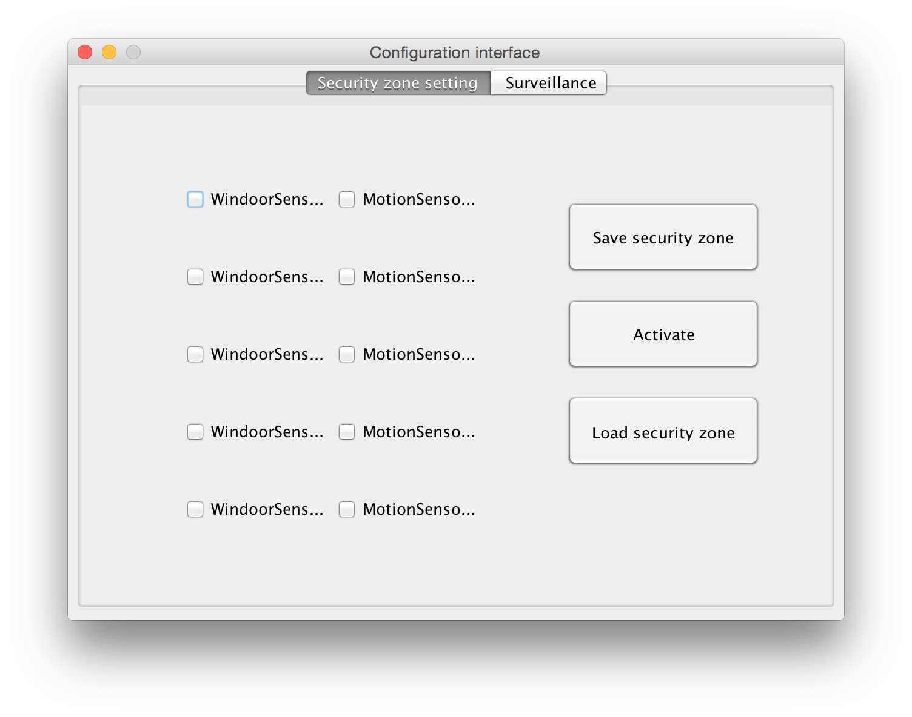
Configuration Interface

Slide 11
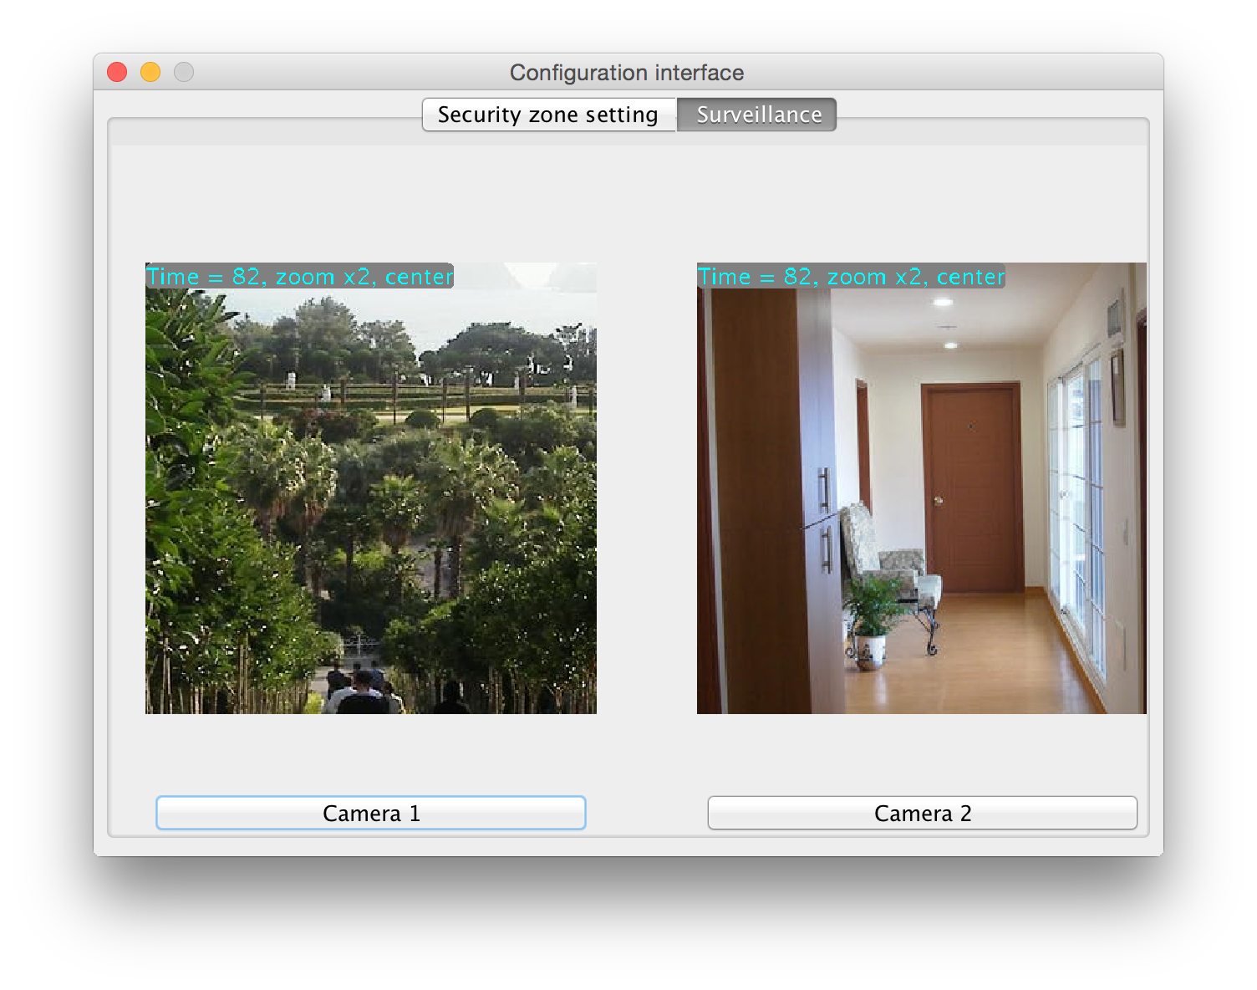
Configuration Interface

Slide 12
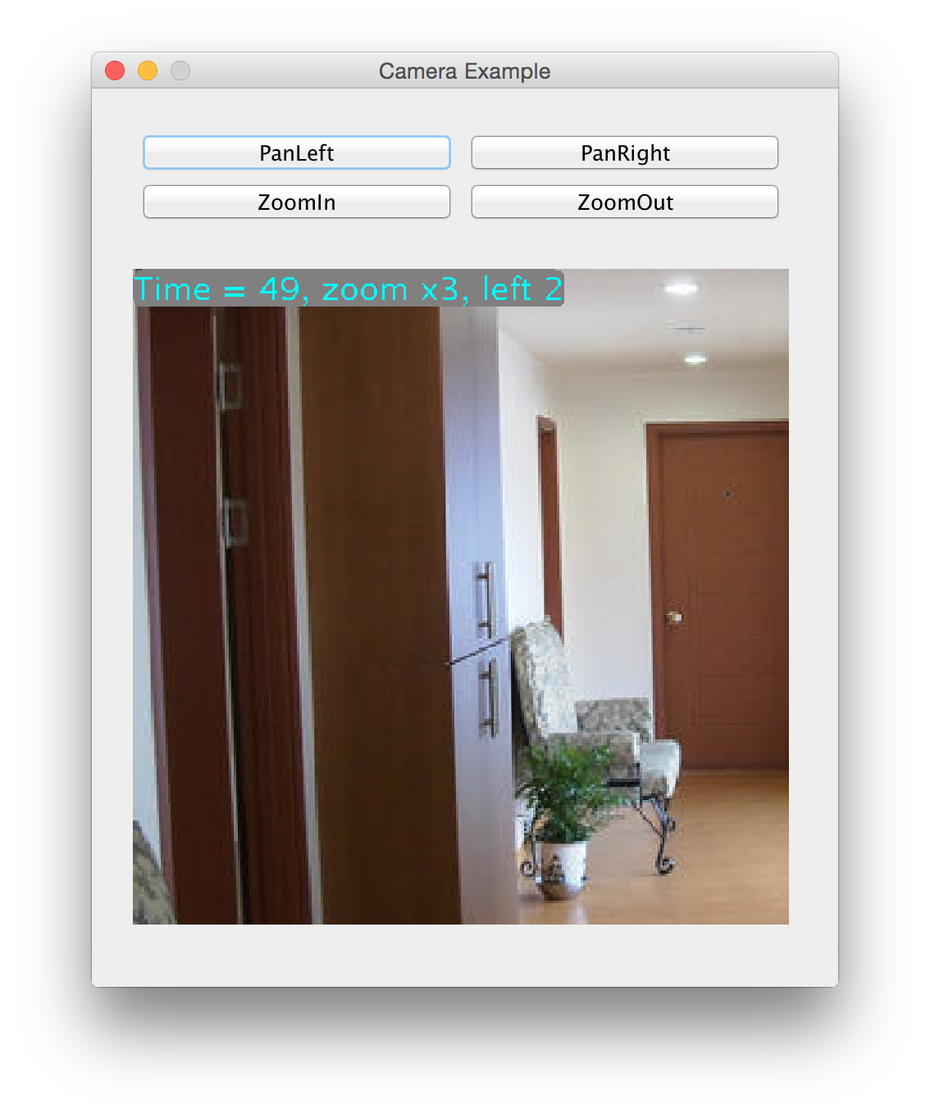
Configuration Interface

Slide 13
Configuration Interface
Supporting features of tab#1 “Security zone setting”
Sensor arming/disarming
Security zone save
Security zone load
Security system arming

Slide 14
Configuration Interface
Supporting features of tab#2 “Surveillance”
Thumbnail of camera
Manipulation of camera
Zoom in/out
Pan left/right

Slide 15
3. Code complexity analysis

Slide 16
Analysis result
Measured with IntelliJ plugin MetricsReloaded
Measured except given API Safehome.device.*
LOC: 2203
# of files: 4
# of classes: 11
# of methods: 58
Other complexity is in the file “overall_analysis.csv”

Slide 17
4. Testing/Coverage result

Slide 18
Total test coverage
7 class covered over 18 classes (38%)
42 methods covered over 102 methods (41%)
278 lines covered over 1222 lines (22%)
Couldn’t perform integration test, and perfect class/methods coverage due to time limitation ☹

Slide 19
Test cases: User.java
testLoginInterface
wrong ID
wrong PW
correct ID/PW
testLoginControlPanel
wrong PW
Invalid(length>4) PW (e.g. 0987654)
Invalid PW(letter included)
Correct PW

Slide 20
Test cases: User.java
testChangeInterfacePassword
wrong original password
invalid password(less than 8 letters)
password change – original password fails/new password succeeds
testChangeControlPanelPassword
wrong original password
Invalid(length>4) new password (e.g. 12345)
Invalid new password (letter included)
password change – original password fails/new password succeeds

Slide 21
Test cases: SafehomeConsoleTest
testArmWindoorSensor/testArmMotionDetector
normal arming
duplicated arming
invalid arming (e.g. 9999 sensor arming)
testDisarmWindoorSensor/testDisarmMotionDetector
normal disarming
invalid disarming (e.g. 9999 sensor disarming)
invalid disarming (disarming non-armed sensor)

Slide 22
Test cases: SafehomeConsoleTest
testArmSystem
not ready test
intruded but not detected test
normal arming system test
testDisarmSystem
thread state test (is thread WAITING?)
sensor arming after system disarmed

Slide 23
Test cases: SafehomeConsoleTest
testResolvePanic
trigger manual panic
resolve test
sensor arming test (after resolve, no sensor is armed)

Slide 24
Test cases: SensorTestTest
testArmWindoorSensor/testArmMotionDetector
similar with the safehomeconsole test
testDisarmWindoorSensor/testDisarmMotionDetector
similar with the safehomeconsole test
testReadWindoorSensor/testReadMotionDetector
intrude – read before arming
intrude – read after arming
read after release

